Slide 1
2.1 Types and methods of data transmission
Data transmission methods

Slide 2




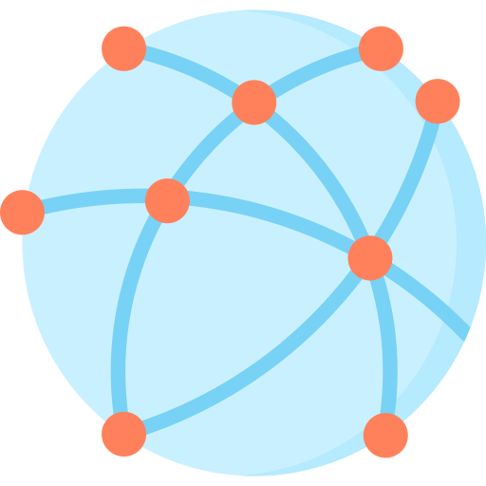


Data transmission
Data transmission can occur over:
Very short distances – e.g., from one component of a computer to another.
Short distances – e.g., from a computer to a local printer.
Long distances – e.g., from one computer to another over a global network.
Very short-distance data transmission
Short-distance data transmission
Long-distance data transmission

Slide 3
Data transmission
When data is being transmitted, we need to consider three essential factors.
Factor 1
Factor 2
Factor 3
Direction of data transmission – e.g., can data be transmitted in both directions or only one?
Method of transmission – e.g., how many bits can be transmitted at once?
How will the data be synchronised?

Slide 4
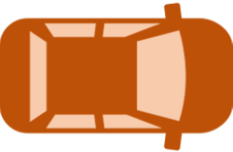


Simplex transmission
Data travels in only one direction via a single cable.
This type of transmission might be used to send data from a computer to a monitor, as traffic only needs to move in one direction.

Slide 5
Half-duplex transmission
Data can travel in both directions via a single cable – but not at the same time.
This type of transmission occurs when using parallel printer cables. A file is sent to the printer, and the printer can respond with error codes such as “Ink low”. However, the printer needs to wait until the computer has finished sending the file.

Slide 6
Full-duplex transmission
Data can travel in both directions at the same time using two communication channels.
This is the most common form of data transmission and is typically used in network cables, both within LANS and across the internet. With these cables, data can be sent and received at the same time.

Slide 7
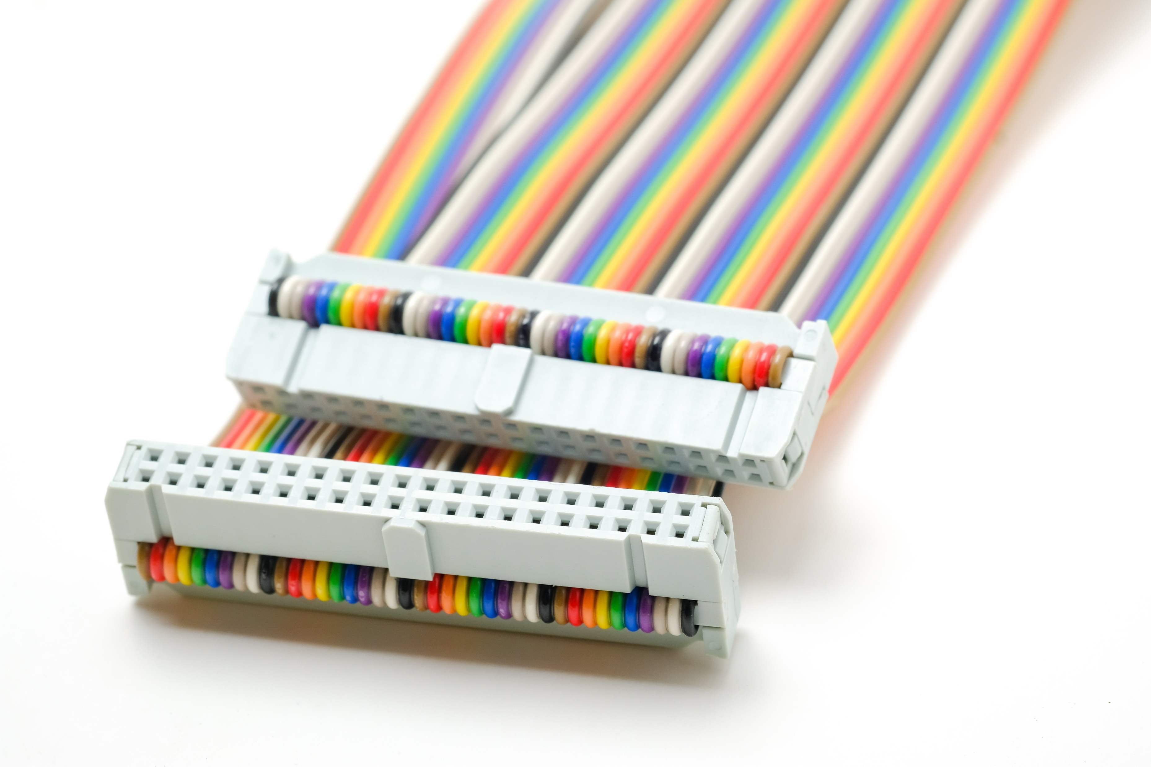

Serial vs parallel transmission
We already know we can transmit data using simplex, half-duplex and full-duplex modes.
Data can also be sent via serial or parallel transmission.
These two sets of terms can be used in conjunction with one another – for example:
Full-duplex serial transmission
Half-duplex parallel transmission

Slide 8


Serial data transmission
Individual bits of data are sent one at a time via a single cable.
0
0
0
1
0
1
1
1

Slide 9

Parallel data transmission
Individual bits of data are sent simultaneously via a series of cables.
1
0
0
0
1
0
1
1

Slide 10


Serial vs parallel transmission
Serial transmission
Minimal interference
Simple and low-cost
Better reliability over longer distances
Lower transmission speeds
Commonly used with the USB (Universal Serial Bus) interface
Parallel transmission
Very fast transmission speeds
Data can be sent in both directions at the same time
Can only be used over very short distances
More prone to interference
Commonly used with printer cables and other internal device connections

Slide 11
Parallel data transmission
In a parallel situation, separate bits of data may travel at different speeds via the various cables – this can cause the bits to arrive out of sync, a problem we refer to as skew.
1
0
0
0
1
0
1
1
That is why parallel cables are only used over very short distances – and another disadvantage against serial cables.

Slide 12

Data transmission methods
The direction that data is allowed to travel via a cable can be described in one of three ways:
Simplex: One direction.
Half-duplex: Both directions, but not at the same time.
Full-duplex: Both directions at the same time.
Along with the direction of data transmission, data can also be sent via serial or parallel transmission.
Serial transmission: Data bits are sent one at a time via a single cable.
Lower interference than parallel.
More reliable over longer distances.
Cheaper to set up.
Parallel transmission: Several bits of data can be sent simultaneously via a series of cables.
More prone to interference.
Data may arrive out of order – known as skew.
Limited to very short distances.
Very fast data transfer.

Slide 13


